Slide 1
CS321: Computer Architecture
Course web:
http://172.16.1.6/~jimson/

Slide 2
Computer Architecture
Basic functional blocks of a computer: CPU, memory, input-output subsystems, control unit.
Instruction set architecture of a CPU - registers, instruction execution cycle, RTL interpretation of instructions, addressing modes, instruction set. Case study - instruction sets of some common
CPUs; Assembly language programming for some processor; Data representation: signed number
representation, fixed and floating point representations, character representation. Computer
arithmetic - integer addition and subtraction, ripple carry adder, carry look-ahead adder, etc.
multiplication – shift-and-add, Booth multiplier, carry save multiplier, etc. Division - non-restoring and restoring techniques, floating point arithmetic; CPU control unit design: hardwired and microprogrammed design approaches, Case study - design of a simple hypothetical CPU; Pipelining:
Basic concepts of pipelining, throughput and speedup, pipeline hazards; Memory organization:
Memory interleaving, concept of hierarchical memory organization, cache memory, cache size vs
block size, mapping functions, replacement algorithms, write policy; Peripheral devices and their characteristics: Input-output subsystems, I/O transfers - program controlled, interrupt driven and
DMA, privileged and non-privileged instructions, software interrupts and exceptions. Programs
and processes - role of interrupts in process state transitions.

Slide 3
Prerequisite & Text Book
Prerequisite: CS225 & CS226
Text Books
David A. Patterson, John L. Hennessy, Computer Organization and Design, Fourth Edition:
The Hardware/Software Interface, Morgan Kaufmann; 4 edition, 2011.
2. A. Tenenbaum, Structured Computer Organization, 4th Ed, Prentice-Hall of India, 1999.
3. W. Stallings, Computer Organization and Architecture: Designing for Performance, 6th
Ed, Prentice Hall, 2005.
4. J. Hennessy and D. Patterson, Computer Architecture A Quantitative Approach, 3rd Ed,
Morgan Kaufmann, 2002..

Slide 4
Evaluation Policy(CS321)
Assignments
& Quizzes : 30%
Mid‐Sem : 15%
End‐Sem : 35%
Mini Project:20 %

Slide 5
Architecture Lab(CS322)
Regular Lab work, 30%
Mid‐Sem : 15%
End‐Sem : 30%
Mini Project:25 %

Slide 6
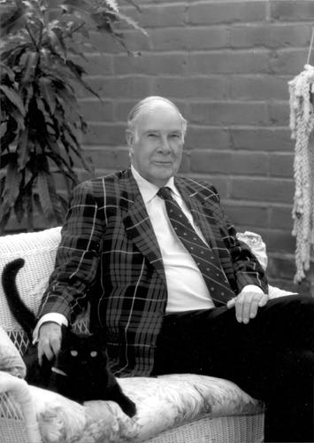
Levels of Transformation
“The purpose of computing is insight” (Richard Hamming)
We gain and generate insight by solving problems
How do we ensure problems are solved by electrons?
Problem
Algorithm
Program/Language
Runtime System
(VM, OS, MM)
ISA (Architecture)
Microarchitecture
Logic
Circuits
Electrons
Notes:
ISA is the interface between hardware and software… It is a contract that the hardware promises to satisfy.
Algorithm: step by step procedure where each step is effectively computable, is definite (precisely defined), and terminates

Slide 7
The Power of Abstraction
Levels of transformation create abstractions
Abstraction: A higher level only needs to know about the interface to the lower level, not how the lower level is implemented
E.g., high-level language programmer does not really need to know what the ISA is and how a computer executes instructions
Abstraction improves productivity
No need to worry about decisions made in underlying levels
E.g., programming in Java vs. C vs. assembly vs. binary vs. by specifying control signals of each transistor every cycle
Then, why would you want to know what goes on underneath or above?

Slide 8
Why CS321?
What if
The program you wrote is running slow?
The program you wrote does not run correctly?
The program you wrote consumes too much energy?
What if
The hardware you designed is too hard to program?
The hardware you designed is too slow because it does not provide the right primitives to the software?

Slide 9
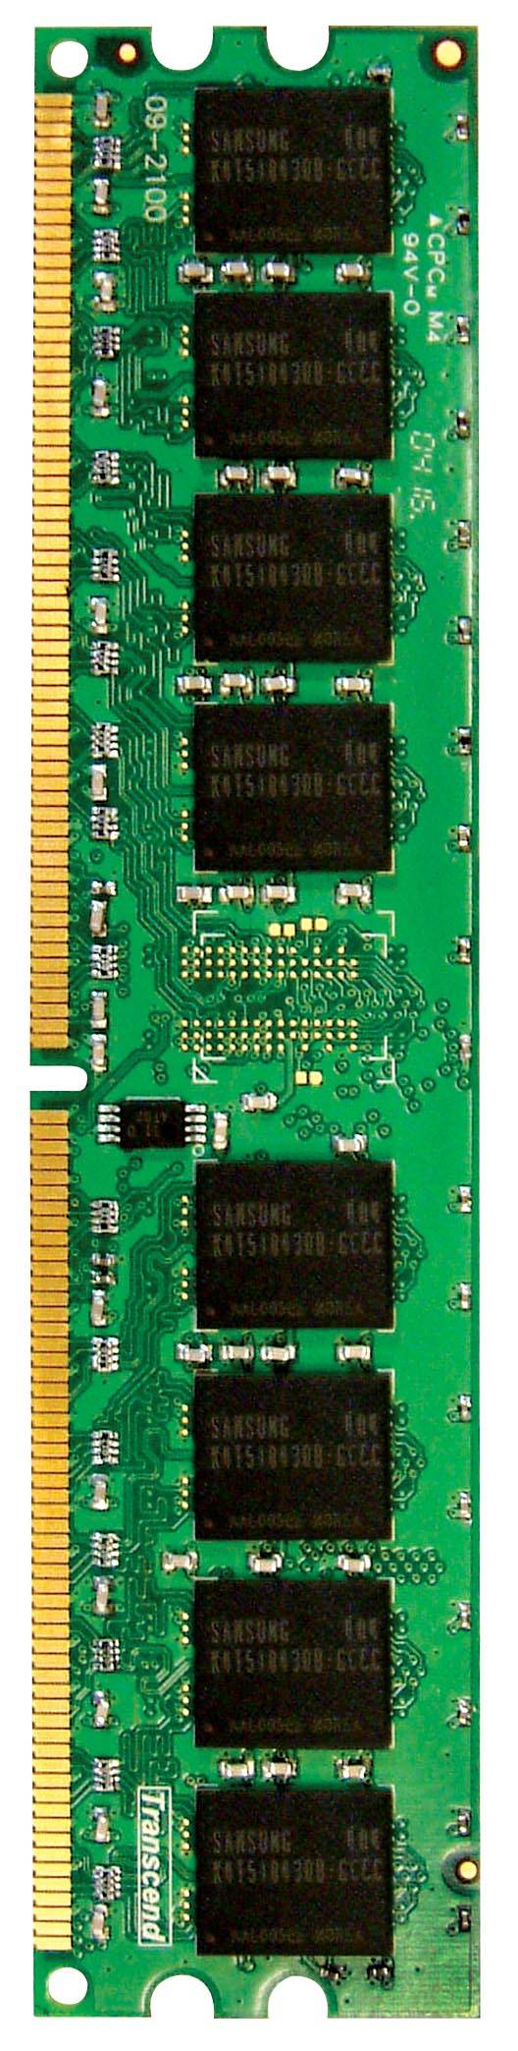
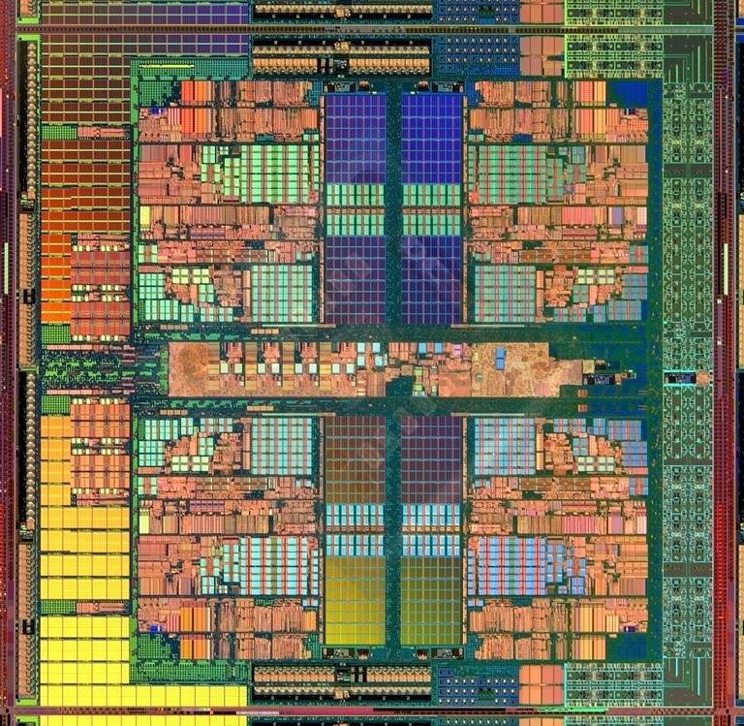
An Example: Multi-Core Systems
Multi-Core
Chip
CORE 0
L2 CACHE 1
CORE 1
L2 CACHE 0
SHARED L3 CACHE
DRAM INTERFACE
DRAM MEMORY CONTROLLER
DRAM BANKS
L2 CACHE 2
CORE 3
CORE 2
L2 CACHE 3
*Die photo credit: AMD Barcelona

Slide 10
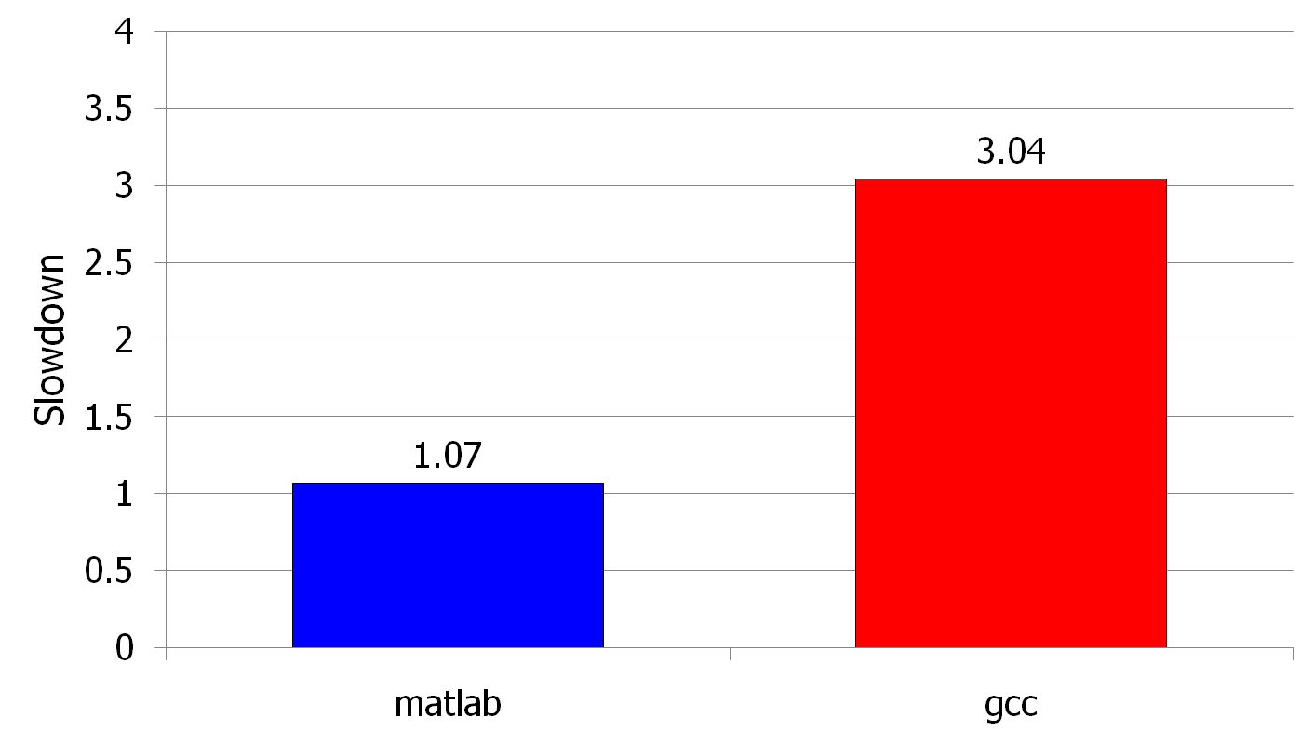
Unexpected Slowdowns in Multi-Core
High priority
Memory Performance Hog
Low priority
(Core 0)
(Core 1)
Moscibroda and Mutlu, “Memory performance attacks: Denial of memory service
in multi-core systems,” USENIX Security 2007.
Notes:
What kind of performance do we expect when we run two applications on a multi-core system? To answer this question, we performed an experiment. We took two applications we cared about, ran them together on different cores in a dual-core system, and measured their slowdown compared to when each is run alone on the same system. This graph shows the slowdown each app experienced. (DATA explanation…)
Why do we get such a large disparity in the slowdowns?
Is it the priorities? No. We went back and gave high priority to gcc and low priority to matlab. The slowdowns did not change at all. Neither the software or the hardware enforced the priorities.
Is it the contention in the disk? We checked for this possibility, but found that these applications did not have any disk accesses in the steady state. They both fit in the physical memory and therefore did not interfere in the disk.
What is it then? Why do we get such large disparity in slowdowns in a dual core system?
I will call such an application a “memory performance hog”
Now, let me tell you why this disparity in slowdowns happens.
Is it that there are other applications or the OS interfering with gcc, stealing its time quantums? No.

Slide 11
A Question or Two
Can you figure out why there is a disparity in slowdowns if you do not know how the processor executes the programs?
Can you fix the problem without knowing what is happening “underneath”?

Slide 12
Why the Disparity in Slowdowns?
CORE 1
gcc
Multi-Core
Chip
matlab
CORE 2
L2
CACHE
L2
CACHE
unfairness
INTERCONNECT
Shared DRAM
Memory System
DRAM MEMORY CONTROLLER
DRAM
Bank 0
DRAM
Bank 1
DRAM
Bank 2
DRAM
Bank 3
Notes:
-In a multi-core chip, different cores share some hardware resources. In particular, they share the DRAM memory system. The shared memory system consists of this and that.
When we run matlab on one core, and gcc on another core, both cores generate memory requests to access the DRAM banks. When these requests arrive at the DRAM controller, the controller favors matlab’s requests over gcc’s requests. As a result, matlab can make progress and continues generating memory requests. These requests are again favored by the DRAM controller over gcc’s requests. Therefore, gcc starves waiting for its requests to be serviced in DRAM whereas matlab makes very quick progress as if it were running alone.
Why does this happen? This is because the algorithms employed by the DRAM controller are unfair.
But, why are these algorithms unfair? Why do they unfairly prioritize matlab accesses?
To understand this, we need to understand how a DRAM bank operates.
Almost all systems today contain multi-core chips
Multi-core systems consist of multiple on-chip cores and caches
Cores share the DRAM memory system
DRAM memory system consists of
DRAM banks that store data (multiple banks to allow parallel accesses)
DRAM memory controller that mediates between cores and DRAM memory
It schedules memory operations generated by cores to DRAM
This talk is about exploiting the unfair algorithms in the memory controllers to perform denial of service to running threads
To understand how this happens, we need to know about how each DRAM bank operates

Slide 13
DRAM Bank Operation
Access Address:
(Row 0, Column 0)
Columns
(Row 0, Column 1)
(Row 0, Column 85)
(Row 1, Column 0)
Row address 0
Row address 1
Row decoder
Rows
Row Buffer
CONFLICT !
HIT
Row 1
HIT
Row 0
Empty
Column address 0
Column mux
Column address 0
Column address 1
Column address 85
Data

Slide 14
INTRODUCTION

Slide 15
Generations of Computer
First Generation - 1940-1956: Vacuum Tubes
Second Generation - 1956-1963: Transistors
Third Generation - 1964-1971: Integrated Circuits
Fourth Generation - 1971-Present: Microprocessors
Fifth Generation - Present and Beyond: Artificial Intelligence

Slide 16
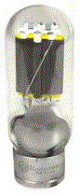
FIRST GENERATION 1940 - 1956
First generation computers used Vacuum Tubes
Vacuum tubes are glass tubes with circuits inside.
The word vacuum indicates that they have no air inside, which protects the circuitry.
Building a computer with these vacuum tubes would result in a very large machine occupying one full room.

Slide 17
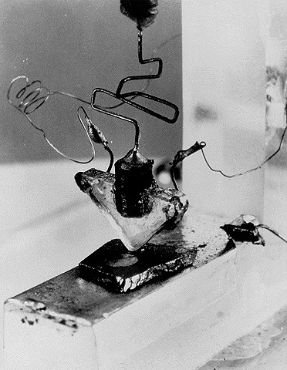
First Transistor
Uses Silicon
developed in 1948
won a Nobel prize
on-off switch
Second Generation Computers used Transistors, starting in 1956

Slide 18
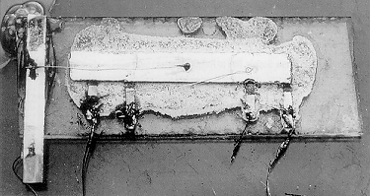
Integrated Circuits
Third Generation Computers used Integrated Circuits (chips).
Integrated Circuits are transistors, resistors, and capacitors integrated together into a single “chip”
Instead of punched cards and printouts, users started interacting with keyboards and mouse.

Slide 19
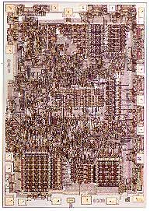
1972: 8008 Microprocessor
The 8008 was twice as powerful as the 4004.
According to the magazine Radio Electronics, Don Lancaster, a dedicated computer hobbyist, used the 8008 to create a predecessor to the first personal computer, a device Radio Electronics dubbed a "TV typewriter." It was used as a dumb terminal.

Slide 20
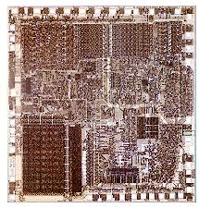
1978: 8086-8088 Microprocessor
In 1978 intel
16-bit
2.5MIPS millions of instructions per second
1M-byte memory
4- or 6-byte instruction (cache) queue that prefetch instructions
over 20,000 variations instructions.
64K bytes of memory found in 8-bit microprocessors to execute efficiently
The 16-bit 8086 and 8088 provided 1M byte of memory for these applications
Popularity of Intel ensured in 1981 when IBM chose the 8088 in its personal computer

Slide 21
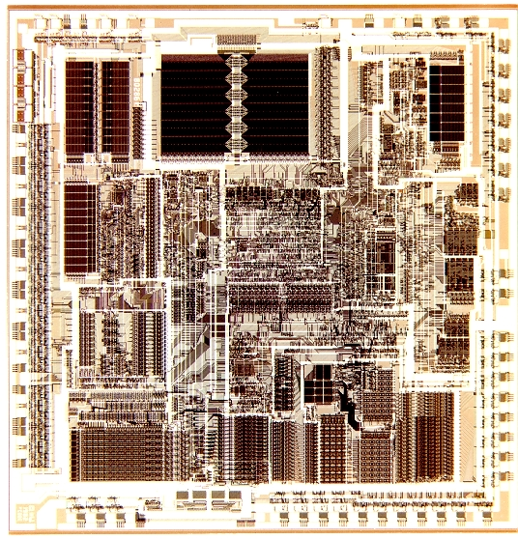
1982: 286 Microprocessor
The 286, also known as the 80286, was the first Intel processor that could run all the software written for its predecessor.
This software compatibility remains a hallmark of Intel's family of microprocessors.
Within 6 years of it release, there were an estimated 15 million 286-based personal computers installed around the world.
80286: updated 8086
16M byte memory addressing
Instructions identical to 8086 few more added
4MIPS
8Mhz clock speed

Slide 22
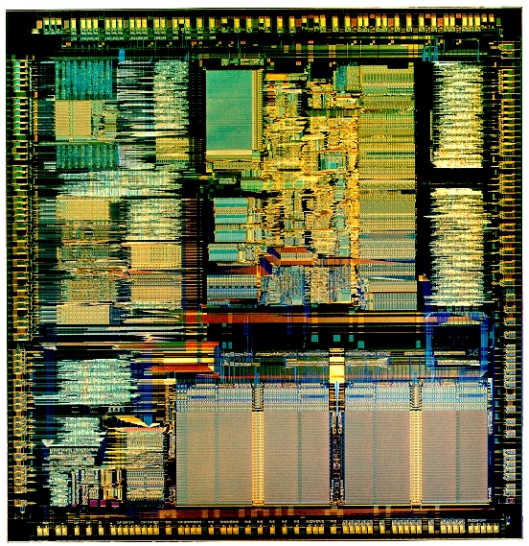
1985: Intel 386(TM) Microprocessor
The Intel 386TM microprocessor featured 275,000 transistors--more than 100times as many as the original 4004.
It was a 32-bit chip and was "multi tasking," meaning it could run multiple programs at the same time.
80386 (1985)
32-bit address bus and 32-bit data bus
4GB memory
Hardware circuitry for memory management
Additional instructions referenced 32-bit registers and managed the memory system

Slide 23
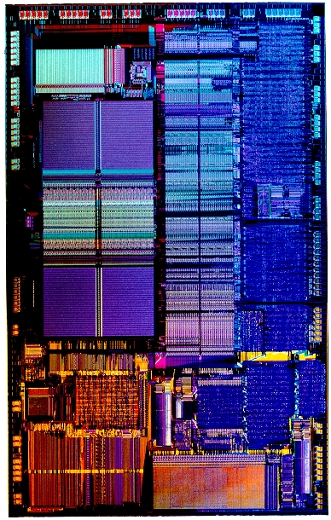
1989: Intel 486(TM) DX CPU
The 486TM generation really allowed the shift from command-level computing into point-and-click computing.
The Intel 486TM processor was the first to offer a built-in math coprocessor, which speeds up computing because it offers complex math functions from the central processor.
80486
Highly integrated package.
80386-like microprocessor.80387-like numeric coprocessor.
50 MIPS
8K-byte cache memory system
Half of its instructions executed in 1 clock cycle rather 2

Slide 24
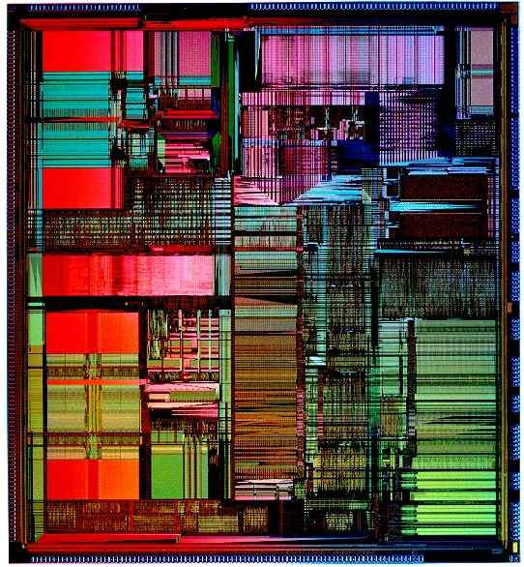
1993: Pentium® Processor
The Pentium® processor allowed computers to more easily incorporate "real world" data such as speech, sound, handwriting and photographic images.
The name Pentium®, mentioned in the comics and on television talk shows, became a household word soon after introduction.
Originally named P5 or 80586
Clock speed of 60MHZ
Executes 110MIPS
Cache size: 16K bytes (8K cache in 80486)
8K-byte instruction cache and data cache.
Memory system up to 4G bytes.
Data bus width increased to a full 64 bits.
Data bus transfer speed 60 MHz or 66 MHz.
depending on the version of the Pentium

Slide 25
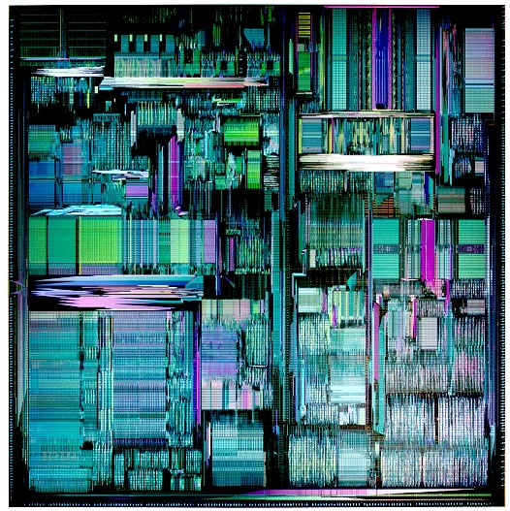
1995: Pentium® Pro Processor
Released in the fall of 1995 the Pentium® Pro processor is designed to fuel 32-bit server and workstation-level applications, enabling fast computer-aided design, mechanical engineering and scientific computation.
Each Pentium® Pro processor is packaged together with a second speed-enhancing cache memory chip.
The powerful Pentium® Pro processor boasts 5.5 million transistors.

Slide 26
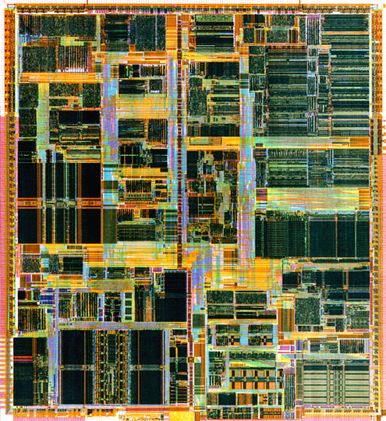
1997: Pentium® II Processor
The 7.5 million-transistor Pentium® II processor incorporates Intel MMXTM technology, which is designed specifically to process video, audio and graphics data efficiently.
It is packaged along with a high-speed cache memory chip in an innovative Single Edge Contact (S.E.C.) cartridge that connects to a motherboard via a single edge connector, as opposed to multiple pins.
With this chip, PC users can capture, edit and share digital photos with friends and family via the Internet; edit and add text, music or between-scene transitions to home movies; and, with a video phone, send video over standard phone lines and the Internet.

Slide 27
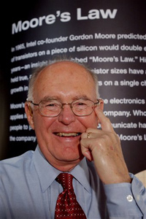
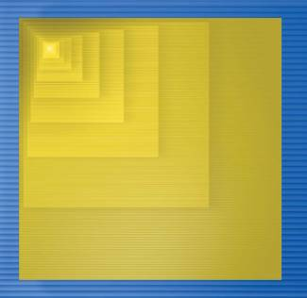
Moore’s Law
IC capacity doubling about every 18 months for several decades
Known as “Moore’s Law” after Gordon Moore, co-founder of Intel
Predicted in 1965 predicted that components per IC would double roughly every year or so
Picture depicts related phenomena
For a particular number of transistors, the IC shrinks by half every 18 months
Notice how much shrinking occurs in just about 10 years
Enables incredibly powerful computation in incredibly tiny devices
Today’s ICs hold billions of transistors
The first Pentium processor (early 1990s) needed only 3 million

Slide 28
Moore’s law in Microprocessors
1000
100
2X growth in 1.96 years!
10
P6
Transistors (MT)
Pentium® proc
1
486
386
0.1
286
Transistors on Lead Microprocessors double every 2 years
8085
8086
0.01
8080
8008
0.001
4004
1970
1980
1990
2000
2010
Year
Courtesy, Intel

Slide 29
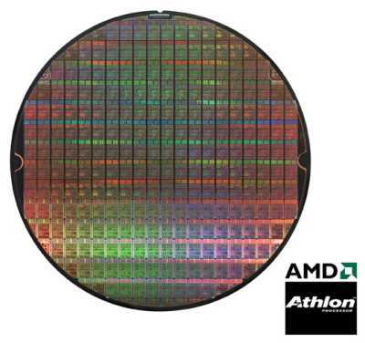
Die
Single die
Wafer
Going up to 12” (30cm)
From http://www.amd.com

Slide 30
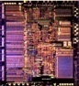
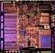
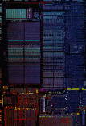




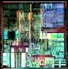
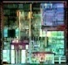
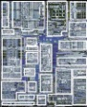
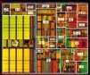
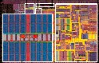
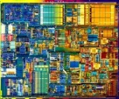
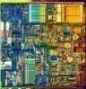
In Picture…
Silicon Process Technology
1.5µ 1.0µ 0.8µ 0.6µ 0.35µ 0.25µ 0.18µ 0.13µ
Intel386™ DX Processor
Intel486™ DX Processor
Pentium® Processor
Pentium® Pro Processor
Pentium® II Processor
Pentium® III Processor
Pentium® 4 Processor
Notes:
P-III sizes –
0.25u 140 mm^2, 9.5 M trans 0KB L2;
01.8 106 mm^2, 28M Trans, 128KB L2;
01.3 79 mm^2, 40M Trans, 512KB L2
P4P sizes –
W 1.75V 2GHZ 75 Watts 217mm^2 42M trans, 256KB L2
N 1.5V 2GHZ 52W, 2.2GHZ 55W 146mm^2 55M tran 512KB L2

Slide 31
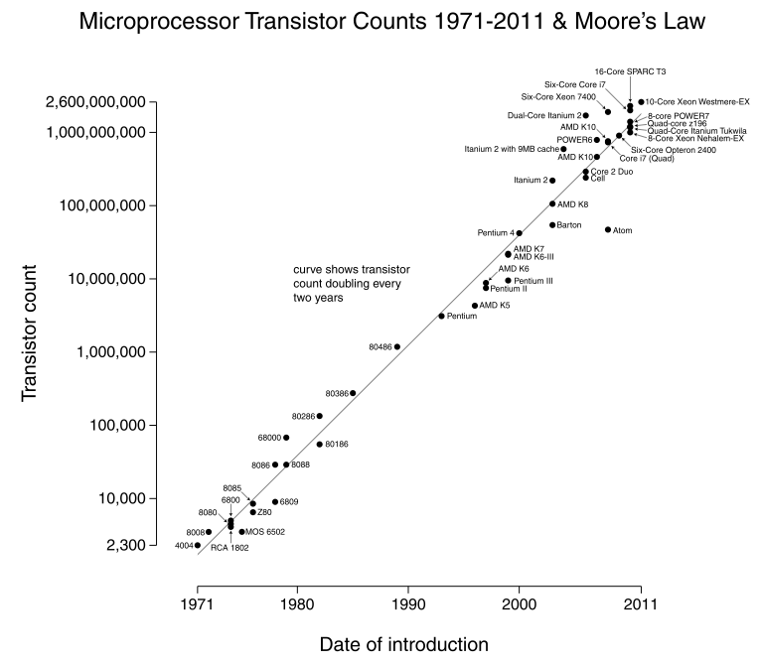
Number of transistors on an integrated circuit doubles ~ every two years
Image source: Wikipedia

Slide 32
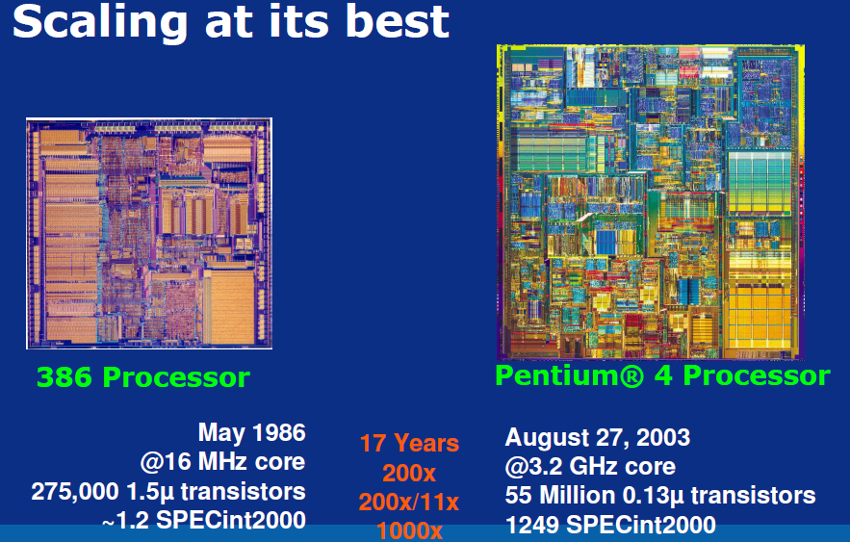
Courtesy, Intel

Slide 33
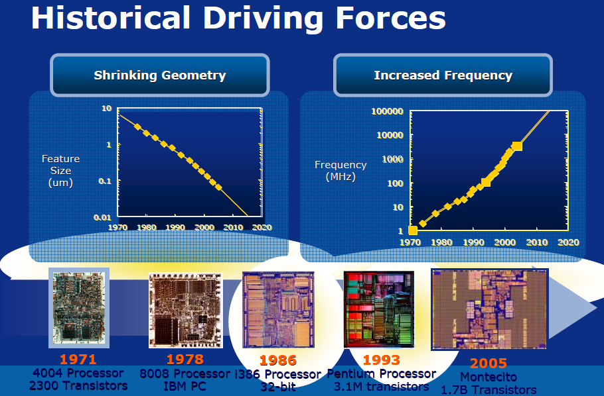
Courtesy, Intel

Slide 34
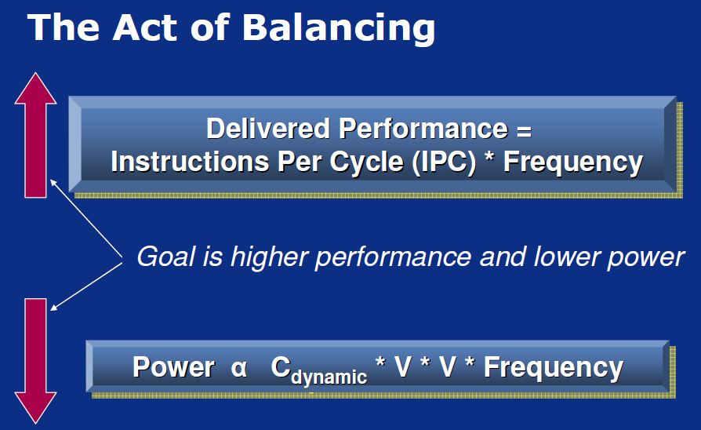
Courtesy, Intel

Slide 35
Power will be a major problem
100000
18KW
10000
5KW
1.5KW
1000
500W
Pentium® proc
Power (Watts)
100
286
486
10
8086
386
8085
8080
1
8008
4004
0.1
1971
1974
1978
1985
1992
2000
2004
2008
Year
Power delivery and dissipation will be prohibitive
Courtesy, Intel

Slide 36
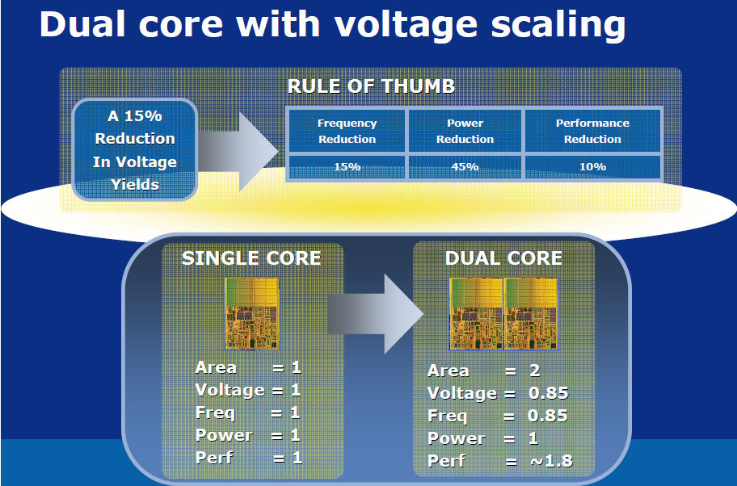
Courtesy, Intel

Slide 37
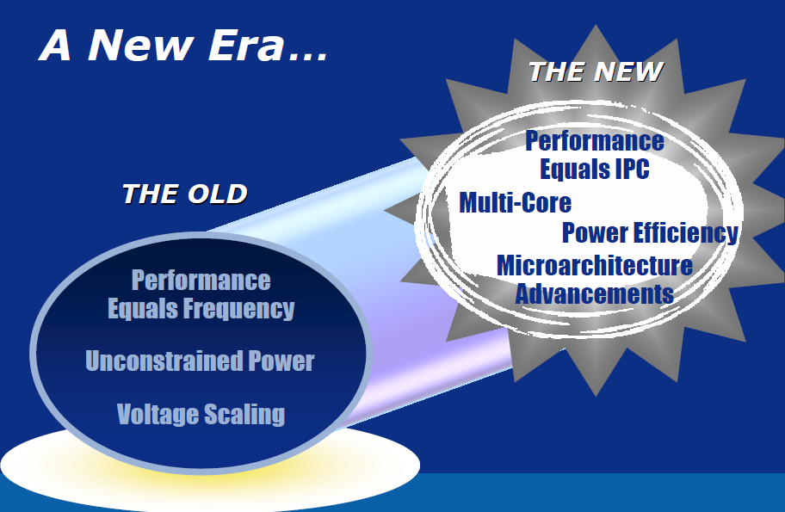
Courtesy, Intel

Slide 38
This Course
Micro-architecture: how to implement an architecture in hardware
Processor:
Datapath: functional blocks
Control: control signals
This Course

Slide 39
What is Computer Architecture?
The science and art of designing, selecting, and interconnecting hardware components and designing the hardware/software interface to create a computing system that meets functional, performance, energy consumption, cost, and other specific goals.
We will soon distinguish between the terms architecture, and microarchitecture.

Slide 40
Why Study Computer Architecture?
Enable better systems: make computers faster, cheaper, smaller, more reliable, …
By exploiting advances and changes in underlying technology/circuits
Enable new applications
Life-like 3D visualization 20 years ago?
Virtual reality?
Enable better solutions to problems
Software innovation is built into trends and changes in computer architecture
> 50% performance improvement per year has enabled
Understand why computers work the way they do

Slide 41
Computer Architecture Today
Today is a very exciting time to study computer architecture
Industry is in a large paradigm shift (to multi-core)
Many problems motivating and caused by the shift
Power/energy constraints
Complexity of design → multi-core
Technology scaling → new technologies
Memory wall/gap
Reliability wall/issues
Programmability wall/problem

Slide 42
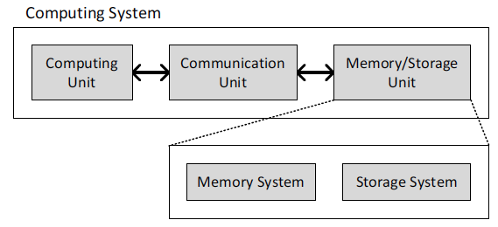
What is A Computer?
Three key components
Computation
Communication
Storage (memory)

Slide 43
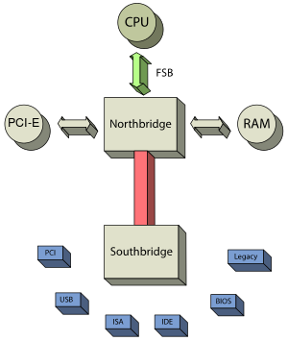
Typical PC Architecture: northbridge or host bridge
front-side bus (FSB)
I/O controller hub

Slide 44
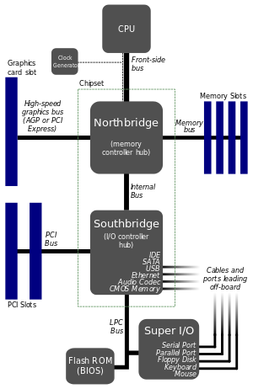
(Typical PC Architecture) northbridge or host bridge
Graphics and Memory Controller Hub
(GMCH)
I/O Controller Hub (ICH)

Slide 45
Intel 945 Express Chipset
Intel
Pentium D Processor
Support for Media Ext Card
DDR2
82945
GMCH/MCH
North Bridge
Intel GMA 950 Graphics
DDR2
PCI Express*
x16 Graphics
4 Serial ATA Ports
Intel HD Audio
82801 GR
ICH7 (io cont. hub sys7)
South Bridge
Integrated Matrix Storage Technology
8 high Speed USB Ports
6 PCI Express*
x1 slot
6 PCI Slots
Intel Pro 100/1000 LAN
Intel Active
Mngement Tech.
BIOS
Support

Slide 46
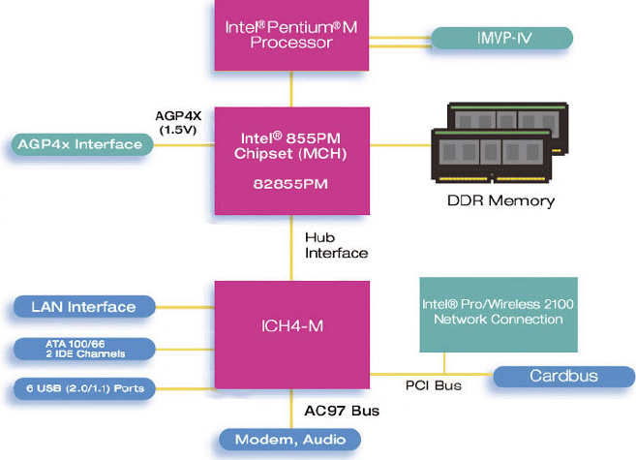
What is A Computer?
Courtesy, Intel

Slide 47
What is A Computer?
We will cover all three components
Processing
Memory
(program
and data)
I/O
control
(sequencing)
datapath

Slide 48
The Von Neumann Model/Architecture
Also called stored program computer (instructions in memory). Two key properties:
Stored program
Instructions stored in a linear memory array
Memory is unified between instructions and data
The interpretation of a stored value depends on the control signals
Sequential instruction processing
One instruction processed (fetched, executed, and completed) at a time
Program counter (instruction pointer) identifies the current instr.
Program counter is advanced sequentially except for control transfer instructions
When is a value interpreted as an instruction?

Slide 49
Dataflow Model (of a Computer)
Von Neumann model: An instruction is fetched and executed in control flow order
As specified by the instruction pointer
Sequential unless explicit control flow instruction
Dataflow model: An instruction is fetched and executed in data flow order
i.e., when its operands are ready
i.e., there is no instruction pointer
Instruction ordering specified by data flow dependence
Each instruction specifies “who” should receive the result
An instruction can “fire” whenever all operands are received
Potentially many instructions can execute at the same time
Inherently more parallel

Slide 50
Von Neumann vs Dataflow
Consider a von Neumann program
What is the significance of the program order?
What is the significance of the storage locations?
Which model is more natural to you as a programmer?
a
b
v <= a + b;
w <= b * 2;
x <= v - w
y <= v + w
z <= x * y
+
*2
-
+
Sequential
*
Dataflow
z

Slide 51
ISA vs. Microarchitecture Level Tradeoff
A similar tradeoff (control vs. data-driven execution) can be made at the microarchitecture level
ISA: Specifies how the programmer sees instructions to be executed
Programmer sees a sequential, control-flow execution order vs.
Programmer sees a data-flow execution order
Microarchitecture: How the underlying implementation actually executes instructions
Microarchitecture can execute instructions in any order as long as it obeys the semantics specified by the ISA when making the instruction results visible to software
Programmer should see the order specified by the ISA

Slide 52
ISA vs. Microarchitecture Level
ISA: Specifies how the programmer sees instructions to be executed
Microarchitecture: How the underlying implementation actually executes instructions
Microarchitecture can execute instructions in any order as long as it obeys the semantics specified by the ISA when making the instruction results visible to software
Programmer should see the order specified by the ISA

Slide 53
The Von-Neumann Model
All major instruction set architectures today use this model
x86, ARM, MIPS, SPARC, Alpha, POWER
Underneath (at the microarchitecture level), the execution model of almost all implementations (or, microarchitectures) is very different
Pipelined instruction execution: Intel 80486 uarch
Multiple instructions at a time: Intel Pentium uarch
Out-of-order execution: Intel Pentium Pro uarch
Separate instruction and data caches
But, what happens underneath that is not consistent with the von Neumann model is not exposed to software
Difference between ISA and microarchitecture

Slide 54
ISA vs. Microarchitecture
ISA
Agreed upon interface between software and hardware
SW/compiler assumes, HW promises
What the software writer needs to know to write and debug system/user programs
Microarchitecture
Specific implementation of an ISA
Not visible to the software
Microprocessor
ISA, uarch, circuits
“Architecture” = ISA + microarchitecture
Problem
Algorithm
Program
ISA
Microarchitecture
Circuits
Electrons
Notes:
ISA is the interface between hardware and software… It is a contract that the hardware promises to satisfy.
Builder/user interface

Slide 55
CISC versus RISC
CISC | RISC
Emphasis on hardware | Emphasis on software
Includes multi-clock complex instructions | Single-clock, reduced instruction only
Memory-to-memory: "LOAD" and "STORE" incorporated in instructions | Register to register: "LOAD" and "STORE" are independent instructions
Small code sizes, high cycles per second | Low cycles per second, large code sizes
Transistors used for storing complex instructions | Spends more transistors on memory registers

